Slide 1




Slide 2
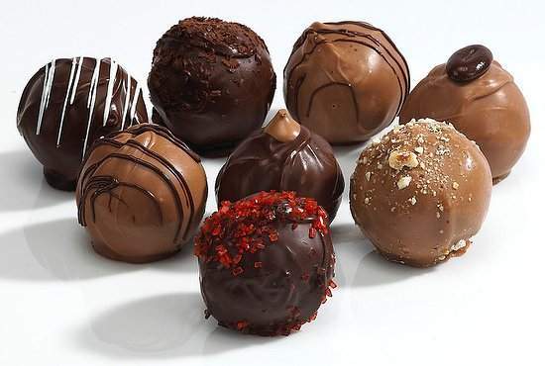
Notes:
Imagine you have a bunch of these individually wrapped chocolates.

Slide 3

Notes:
You’re want to give some as a gift to your friend. But, you only have 2 fingers, so you can only pick up one item at a time.

Slide 4
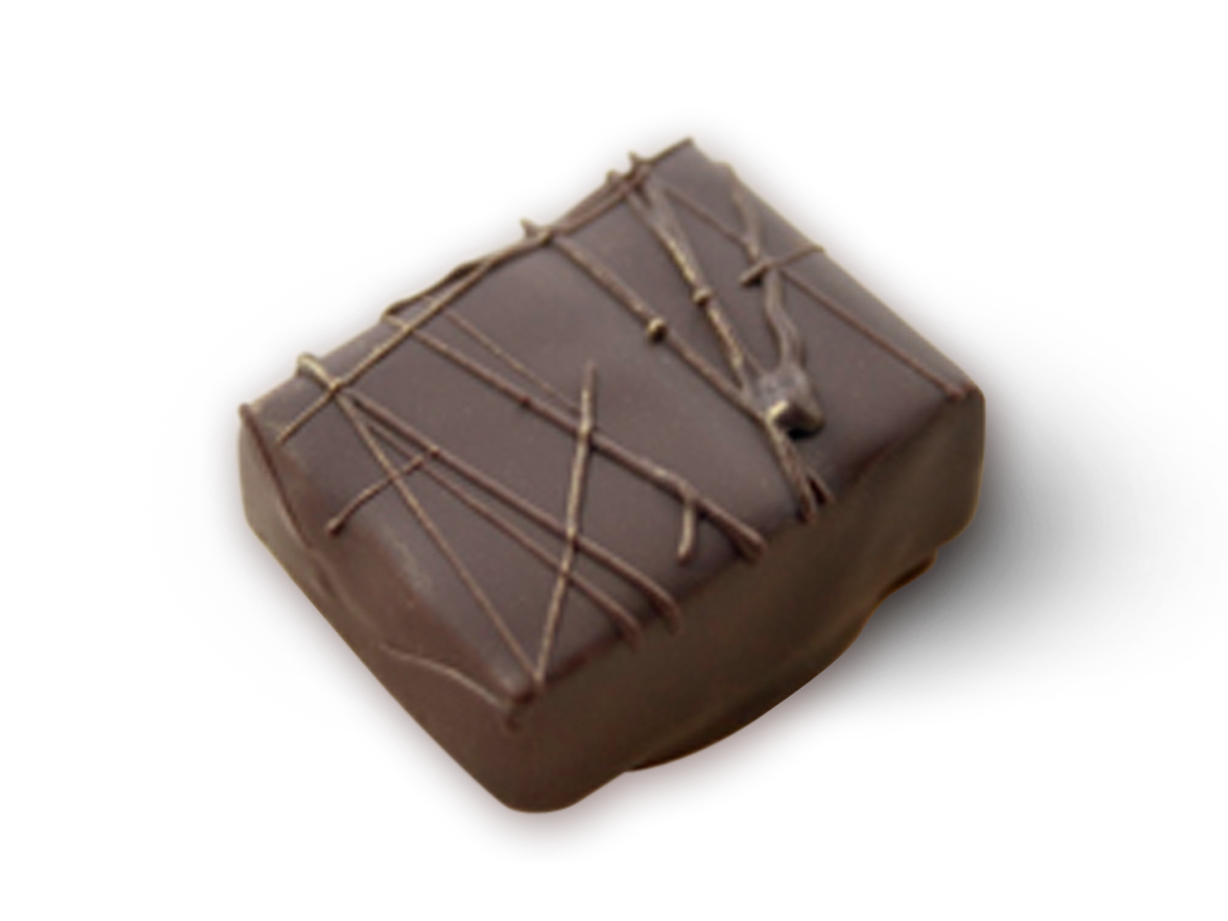
Notes:
This is all you can bring for your friend. One small measly chocolate. If you want to give more, you have to drive for 15 minutes back home, and then another 15 minutes back to your friend’s house. What can solve this problem?

Slide 5
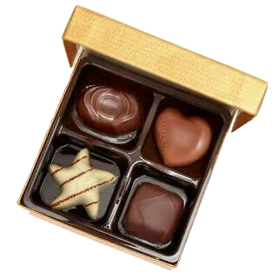
Notes:
A chocolate box! It will help you hold multiple chocolates in one container. Now, we think of these chocolates as variable values in Java.

Slide 6
String chocolate1 = “Milk”;
String chocolate2 = “Dark”;
String chocolate3 = “White”;
String chocolate4 = “Caramel”;
String[] chocolateBox = {“Milk”, “Dark”, “White”, “Caramel”};
chocolateBox
“Milk” | “Dark” | “White” | “Caramel”
Arrays are used to store multiple values in one variable.
Notes:
Take these 4 lines of code. I have 4 different lines of code to initialize 4 different types of chocolates. Now, compare it to this one line. This is an array. It may seem intimidating, but I will break it down in a minute. First, notice that this variable, “chocolateBox,” was only set up with one line, but has all 4 strings. Arrays are used to store multiple values in one variable.

Slide 7
Type of value the array will store
Brackets to surround the array elements
Name of array
String[] chocolateBox = {“Milk”, “Dark”, “White”, “Caramel”};
Square brackets to tell the program the variable is an array
Elements separated by commas
chocolateBox
“Milk” | “Dark” | “White” | “Caramel”
Notes:
Know that like a chocolate box, you can’t change the number of elements in an array. So here, our array chocolateBox will always hold 4 strings.

Slide 8
Access array elements with: arrayName[indexValue]
String[] chocolateBox = {“Milk”, “Dark”, “White”, “Caramel”};
chocolateBox
“Milk” | “Dark” | “White” | “Caramel”
0 | 1 | 2 | 3
Array counting starts at 0!
Notes:
First one is 1, second one is 2, etc, right? Sike it starts at 0.

Slide 9
String[] chocolateBox = {“Milk”, “Dark”, “White”, “Caramel”};
chocolateBox
“Milk” | “Dark” | “White” | “Caramel”
0 | 1 | 2 | 3
Output
System.out.println(chocolateBox[1]);
White
Dark
System.out.println(chocolateBox[2]);
Notes:
Example of accessing an array.

Slide 10
Change array elements with: arrayName[indexValue] = newValue;
String[] chocolateBox = {“Milk”, “Dark”, “White”, “Caramel”};
chocolateBox
“Milk” | “Dark” | “White” | “Caramel”
0 | 1 | 2 | 3
chocolateBox[3] = “Strawberry”;
“Milk” | “Dark” | “White” | “Strawberry”
0 | 1 | 2 | 3
Notes:
Example of changing element.

Slide 11
Practice Problem!
Make an array called colors with the 7 colors below.
colors
“Red” | “Orange” | “Yellow” | “Green” | “Blue” | “Brown” | “Purple”
But, brown is not a color of the rainbow. Change it to “Indigo.”
To make sure it worked, print “Indigo” from the array.
public static void main(String[] args) {
String[] colors = {___};
____ = "Indigo";
System.out.println(arrayName[indexValue]);
}

Slide 12
Use arrayName.length to get the number of elements in an array
String[] chocolateBox = {“Milk”, “Dark”, “White”, “Caramel”};
System.out.println(chocolateBox.length);
4
int[] favoriteNumbers = {3, 7, 419, 68, 20, 2020, 13};
System.out.println(favoriteNumbers.length);
7
Notes:
Examples of .length

Slide 13
Practice Problem!
Make an array called favoriteColors with all the colors you like.
Then, make your code print how many colors are in the array using arrayName.length.
Finally, use your knowledge of for loops to make your program print every single color in the array.
public static void main(String[] args) {
String[] favColors = {___};
System.out.println(“My ” + ___ + “ favorite colors are:”);
for (___; ___; ___) {
System.out.println(___);
}
}

Slide 14
Homework
Make an array listing your family members, or the members of a K-pop group.
Make it print how many people there are, then make it print the name of the oldest person.
public static void main(String[] args) {
String[] members = {___};
System.out.println(“___ has ” + ___ + “ members”);
System.out.println(___ + “ is the oldest.”);
}

